Slide 1

Unit 6:Distributed Memory Architecture.
Point 1–Loosely Coupled Architecture – Kmap,Intracluster and Intercluster communication
Dr. Mrs Mamata Sachin Kalas
Email id:kalas.mamta@kitcoek.in

Slide 2
Introduction
A multiprocessor system is an interconnection of two or more CPUs with memory and input-output equipment.
The term “processor” in multiprocessor can mean either a central processing unit (CPU) or an input-output processor (IOP).
Multiprocessors are classified as multiple instruction stream, multiple data stream (MIMD) systems.
Unit 6:Distributed Memory Architecture-Point 1.Loosely coupled architecture

Slide 3
Loosely Coupled Multiprocessor
Each processor has a set of input-output devices and a large local memory.
Computer module: processor, local memory, i/o interface.
Processes in different CM communicates through MTS.
Degree of coupling is loose which is determined by communication topology of MTS.
Efficient when interactions are minimum.
Unit 6:Distributed Memory Architecture-Point 1.Loosely coupled architecture

Slide 4
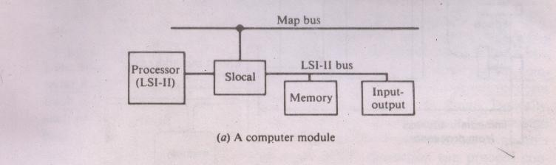
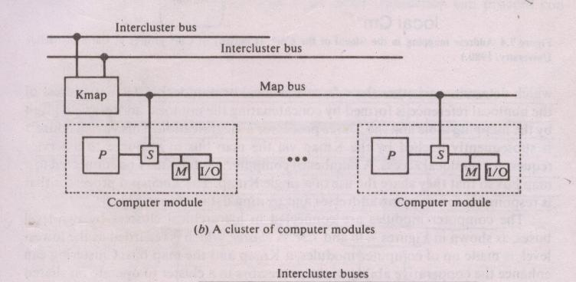
Example: cm* Architecture
Unit 6:Distributed Memory Architecture-Point 1.Loosely coupled architecture

Slide 5
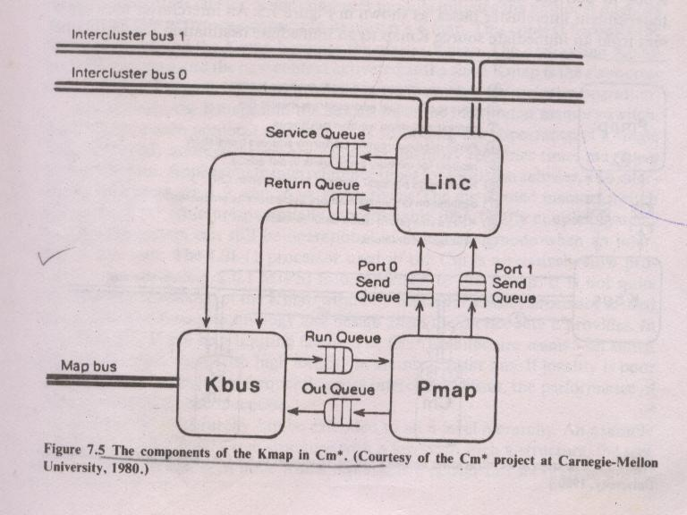
Kmap
Unit 6:Distributed Memory Architecture-Point 1.Loosely coupled architecture

Slide 6
Components of K map
Kbus-Bus controller arbitrates the requests to mapbus.
Linc –managescommunication between Kmap and other Kmap.
Pmap-Mapping processor responds to requests from Kbus and Linc.
Performs most of the request processing.
Three sets of queues provide interfaces between Kbus,Linc and Pmap.
Kmap is multiprogrammed to handle 8 concurrent requests(partitions) called context.
Unit 6:Distributed Memory Architecture-Point 1.Loosely coupled architecture

Slide 7
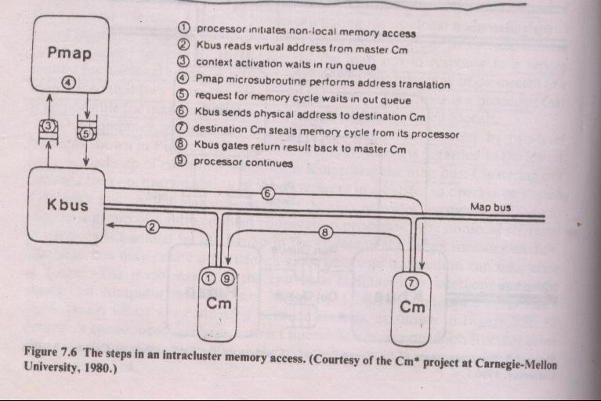
Intracluster communication
Unit 6:Distributed Memory Architecture-Point 1.Loosely coupled architecture

Slide 8
Steps in Intracluster Communication
Whenever processor of computer module makes nonlocal reference-Master Cm.
In response to service requests,Kbus allocates Pmap context and fetches virtual address of memory reference via mapbus.
Kbus activates new context containing virtual address.
Pmap context performs virtual to physical address translation.
Context is initiated invoking Kbus operation by loading request in to Kbus outqueue.
Pmap makes context switch to another runnable context.
Kmap services out requests by sending physical address via mapbus to destination Cm.
Destination Cm completes memory access, signals return request to Kmap.
Unit 6:Distributed Memory Architecture-Point 1.Loosely coupled architecture

Slide 9
Intercluster memory access
Intercluster memory access is done by passing messages via intercluster bus.
Messages are of two types:
Forward message
Return message
Forward msg invokes new context at dest Kmap. It also contains source Kmap number and originating Pmap context number.
Return msg contains the context number of the context to be reactivated.
Unit 6:Distributed Memory Architecture-Point 1.Loosely coupled architecture

Slide 10
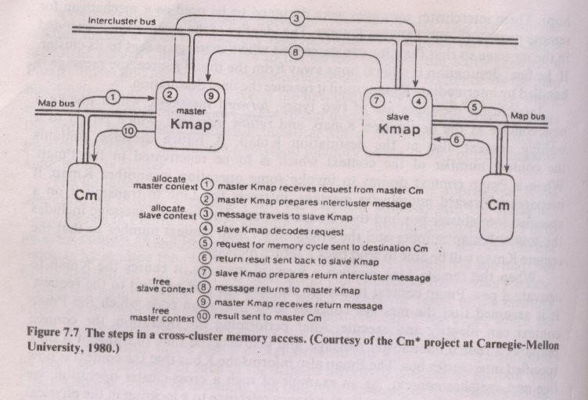
Intercluster memory access
Unit 6:Distributed Memory Architecture-Point 1.Loosely coupled architecture

